Slide 1

Maharishi Core Banking System
Group Members:
Bereket Gebremeskel
Mubarak Adeshina
Nahu Merawi
XSron Hou

Slide 2
Problem Statement
Maharishi university currently relies on an external bank to provide loan for international students that attend the ComPro program. This is not convenient for the school because there needs to be a special agreement with the school and the bank to facilitate this loan service.

Slide 3
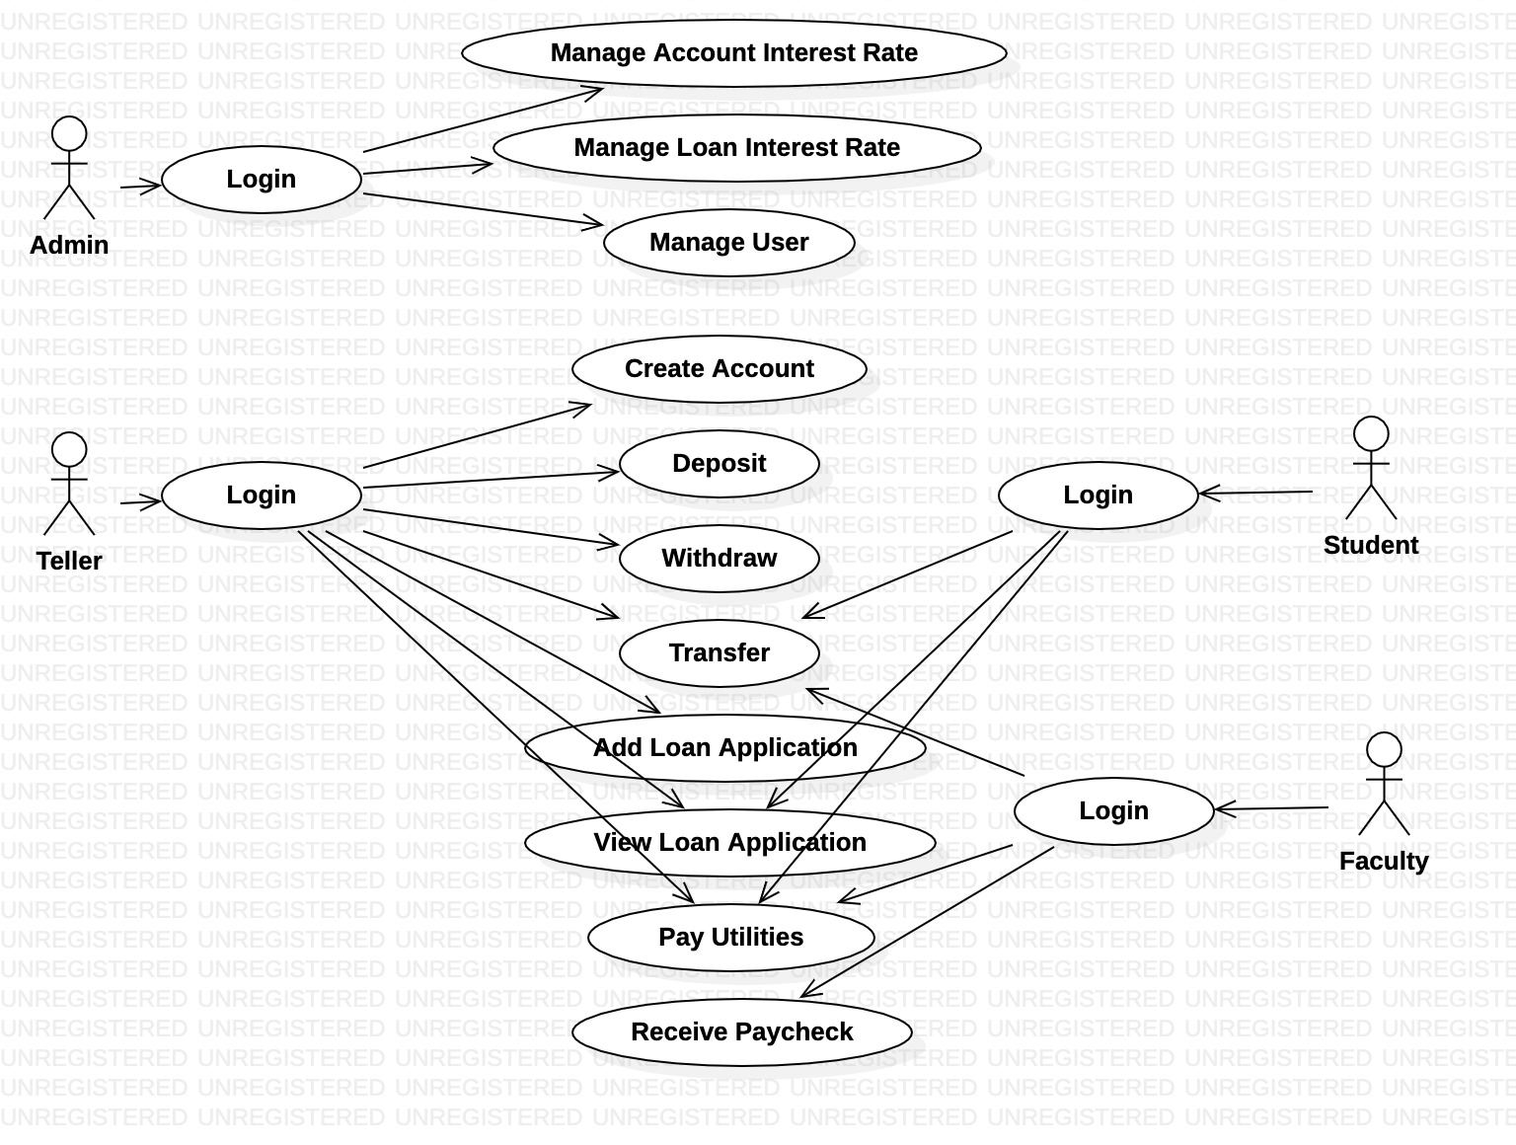
Use case Diagram

Slide 4
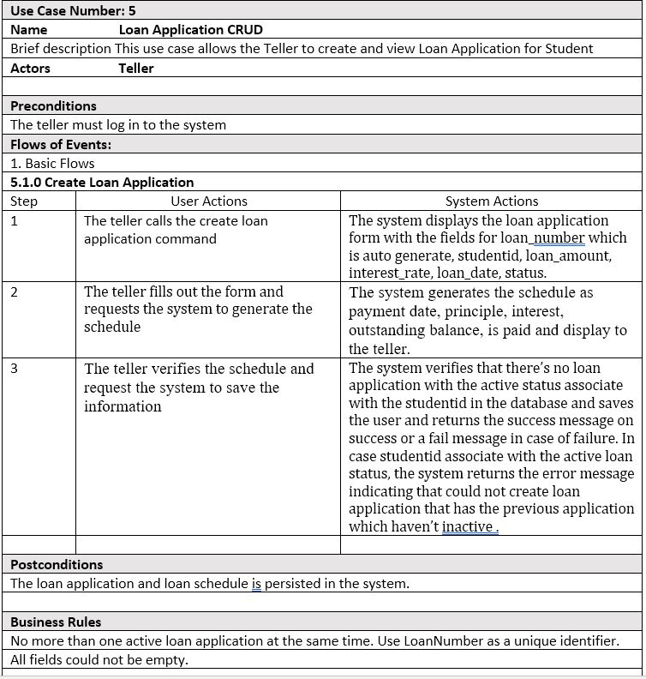
Loan Application Use-Case Description

Slide 5
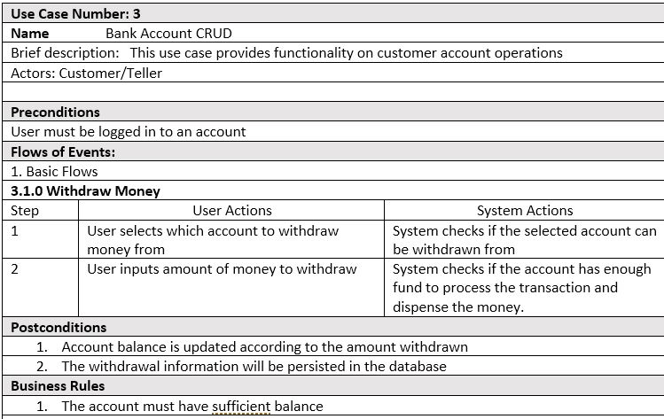
Withdraw Use-Case Description

Slide 6

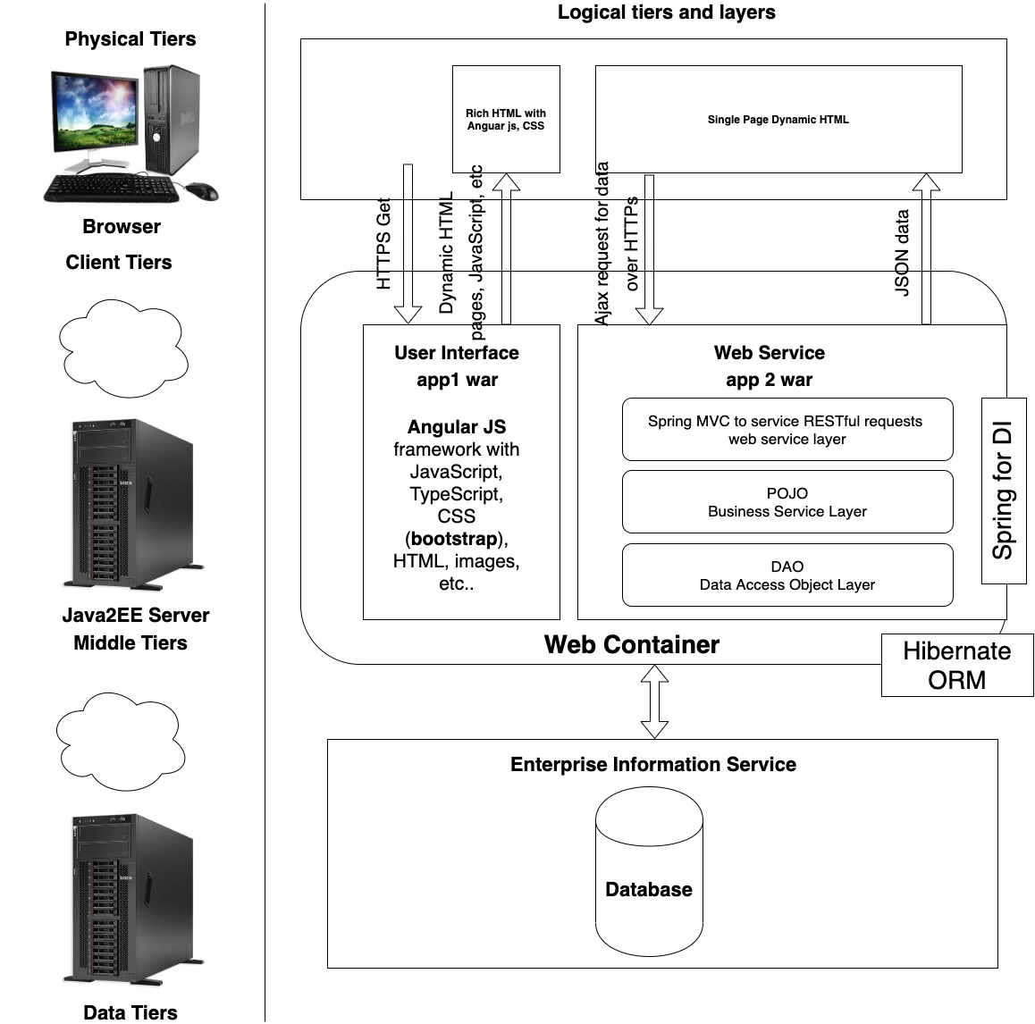

Slide 7
Key Abstractions
Bank Account
Teller
Student
Admin
Faculty
Loan Application
Payment Schedule
Transaction Record
Paycheck

Slide 8
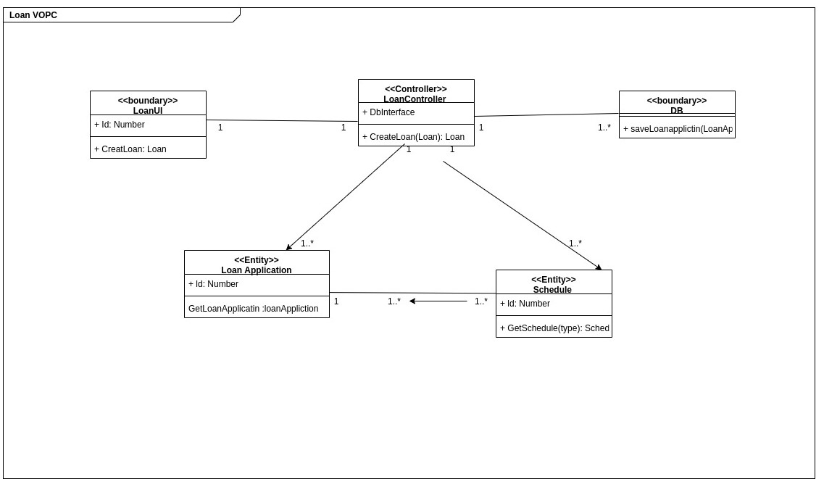

Slide 9
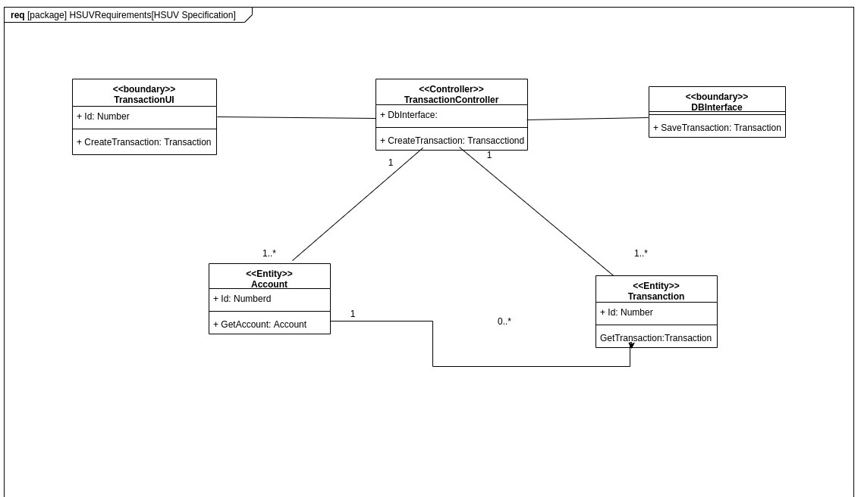

Slide 10
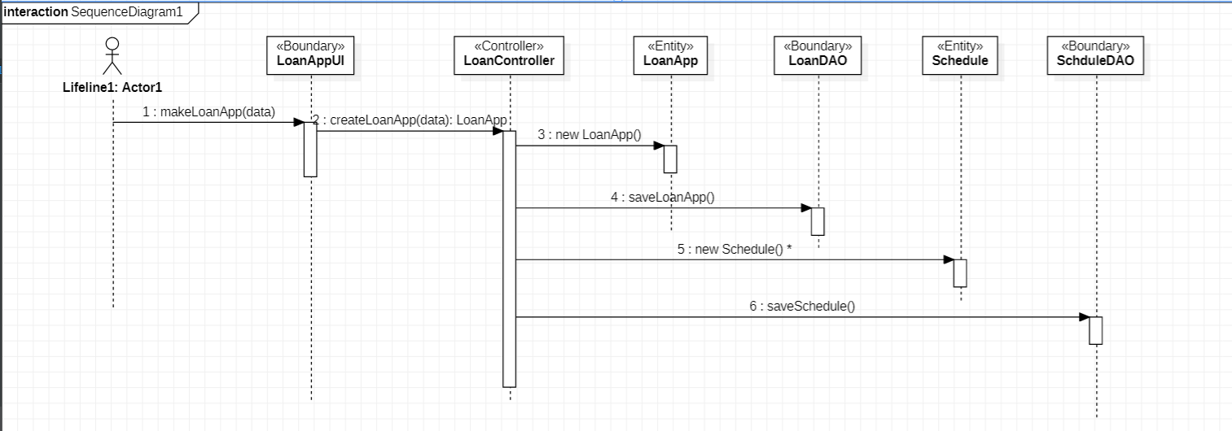

Slide 11
Thank You!!!

